Slide 1




Track 5 – Digital Life Sciences, Health, Agriculture & Biodiversity
11–12 December 2026 · NIELIT Guwahati, Gauhati University Campus
Shortcuts and Temporal Leakage in the Bangalore EEG Epilepsy Dataset
A Provenance Audit and Leakage-Aware Benchmark of Lightweight Seizure-Type Classifiers
Er. Rishabh Aryan
M.Tech (Artificial Intelligence and Data Science),
Department of Computer Science and Engineering,
Indian Institute of Information Technology, Bhagalpur (Bihar)
E-mail: rishabh.250201011@iiitbh.ac.in
ORCID ID: https://orcid.org/0009-0004-7595-9440
NIELIT Bio-AI Conclave 2026
Notes:
Speaker notes: Good morning. I am Rishabh Aryan from IIIT Bhagalpur. This talk presents a provenance audit and a leakage-aware benchmark of the Bangalore EEG Epilepsy Dataset, BEED, and asks how much of its reported performance survives once two shortcuts are removed: the origin of the healthy class and temporal leakage between neighbouring rows.
Sources: Title and subtitle: BEED_paper_camera_ready.docx (title line); Presenter, affiliation, e-mail and ORCID: as supplied by the presenter; Conclave name, Track 5, dates and venue: NIELIT Bio-AI Conclave 2026 call for papers.

Slide 2
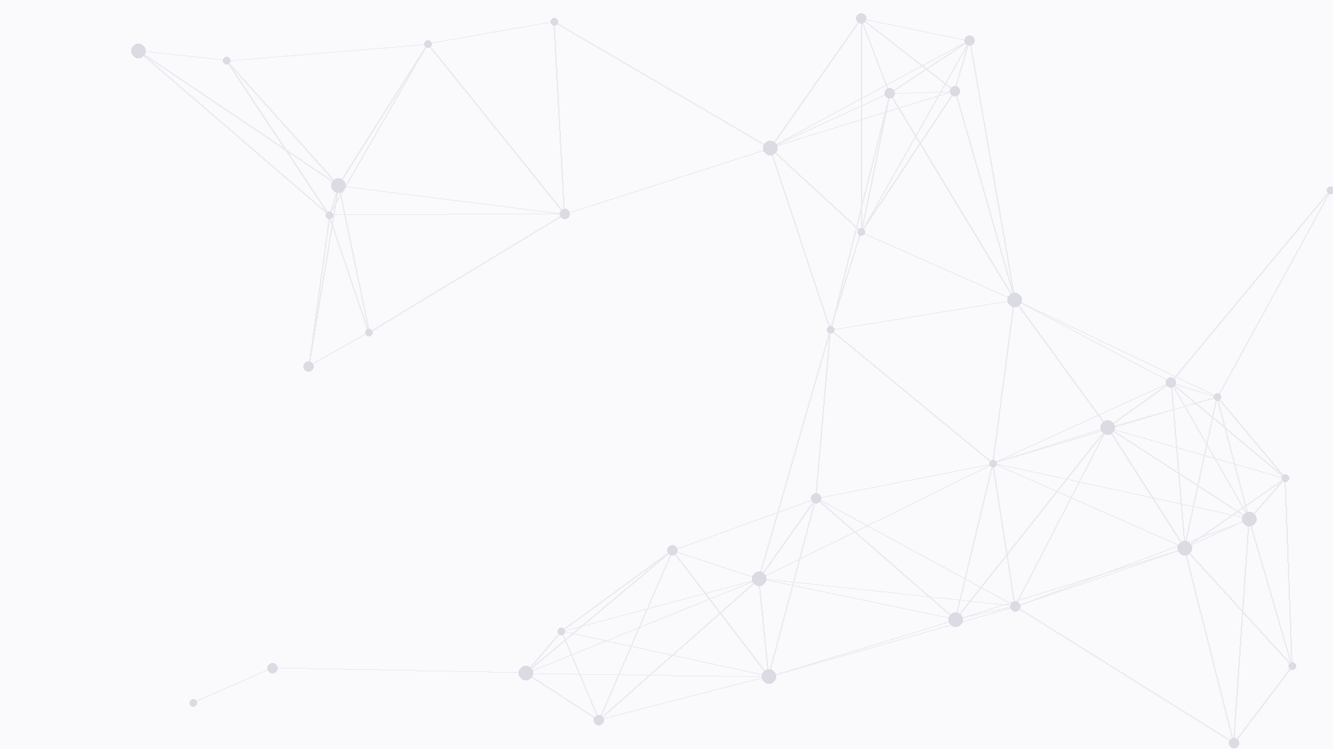


Outline
1. Introduction
Motivation, the BEED dataset, research questions
4. Results
Split comparison, recording fingerprint, computational footprint
2. Dataset Audit
Healthy-class provenance, temporal leakage
5. Discussion
Limitations of the dataset and the study
3. Methodology
Leakage-safe splits, models and statistical tests
6. Conclusion
Takeaways and future work
NIELIT Bio-AI Conclave 2026 · Track 5
2 / 16
Notes:
Speaker notes: The talk has six parts. I first introduce the motivation, the BEED dataset and the four research questions. Then I present the dataset audit: where the healthy class comes from and how temporal leakage arises. After the methodology, I show three results: the comparison of random and leakage-safe splits, the recording fingerprint that a simple per-channel amplitude feature already captures, and the computational footprint of the models on a general-purpose CPU. I then discuss the limitations and close with the takeaways and future work.
Sources: Outline of the talk: six numbered sections; section structure follows BEED_paper_camera_ready.docx, revised for v2 per /workspace/beed/revision_v2/REVISION_RESULTS.md (R1 split comparison, R4 recording fingerprint, R8 computational footprint).

Slide 3
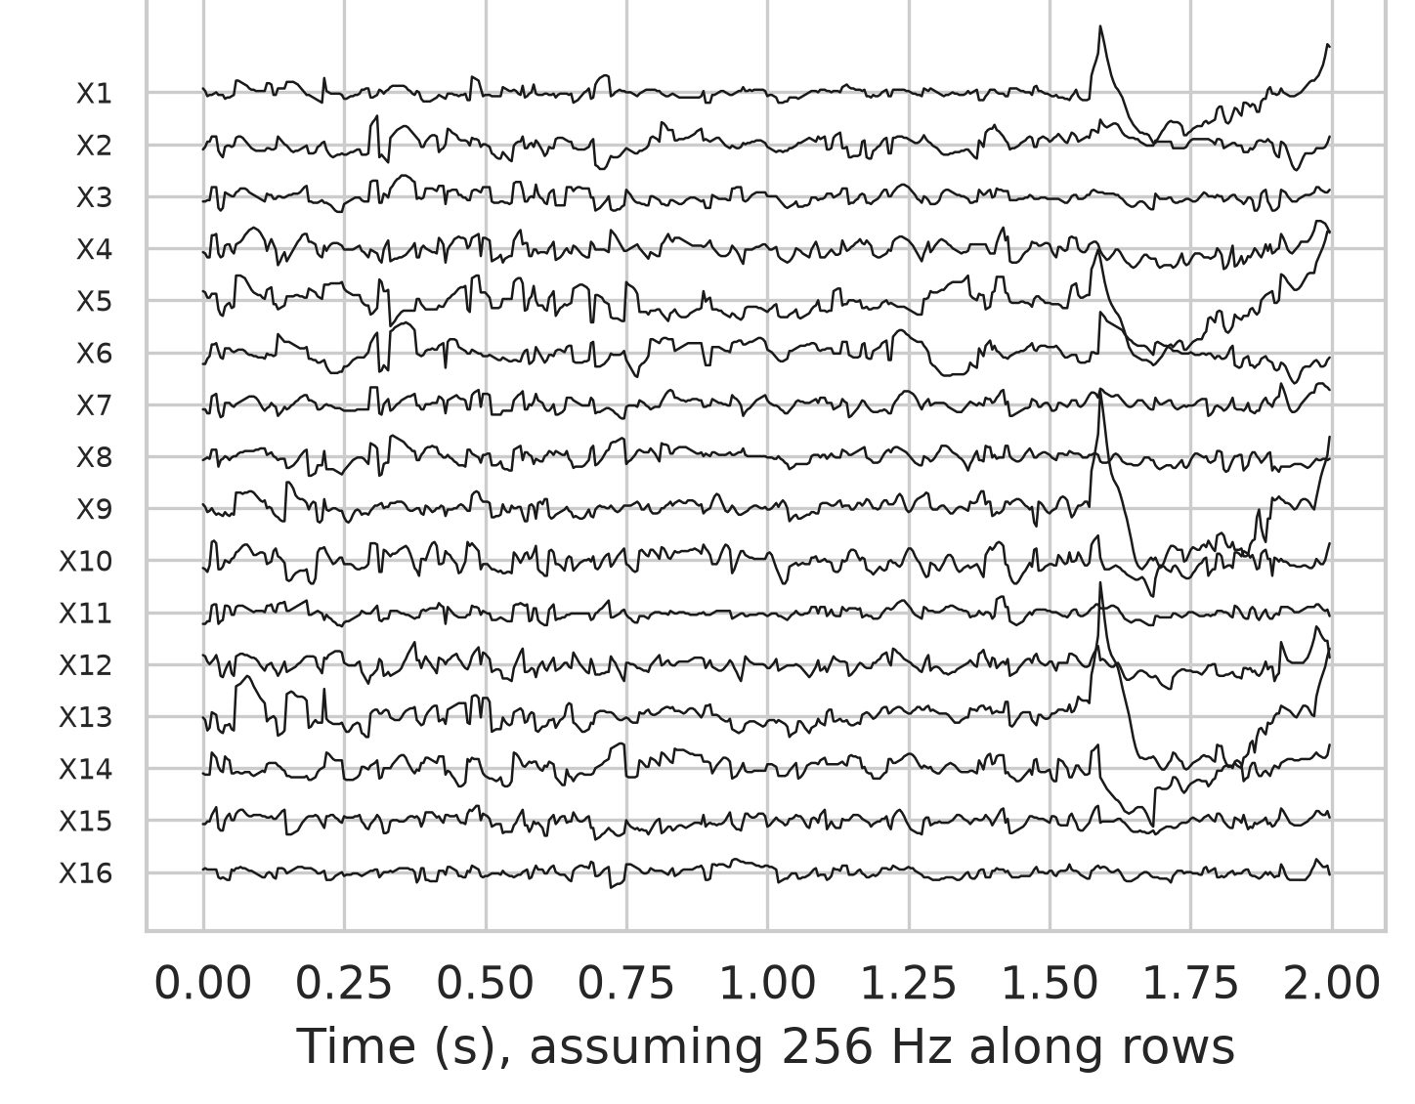
1. Introduction: Motivation
Epilepsy affects about 50 million people worldwide [4].
Visual EEG review is expert-intensive and slow.
Automated seizure-type classification could support clinicians.
Public benchmarks like BEED [1] drive models; their validity matters.
Fig. 1. BEED focal-seizure class: 512 consecutive rows drawn as 16 traces [1].
NIELIT Bio-AI Conclave 2026 · Track 5
3 / 16
Notes:
Speaker notes: Epilepsy affects about 50 million people worldwide. Visual EEG review is expert-intensive and slow, so automated seizure-type classification could support clinicians. Public benchmarks such as BEED drive which models get built, so their validity matters. The figure shows 512 consecutive rows of the BEED focal-seizure class drawn as 16 traces.
Sources: Epilepsy prevalence (about 50 million people worldwide) [4]: WHO epilepsy fact sheet, https://www.who.int/news-room/fact-sheets/detail/epilepsy; [1] Najmusseher N, Nizar Banu PK. BEED: Bangalore EEG Epilepsy Dataset [dataset]. UCI Machine Learning Repository. 2024. doi:10.24432/C5K33B; Figure: /workspace/beed/deliverables/code/figures/fig_examples.png, panel (b), cropped.

Slide 4
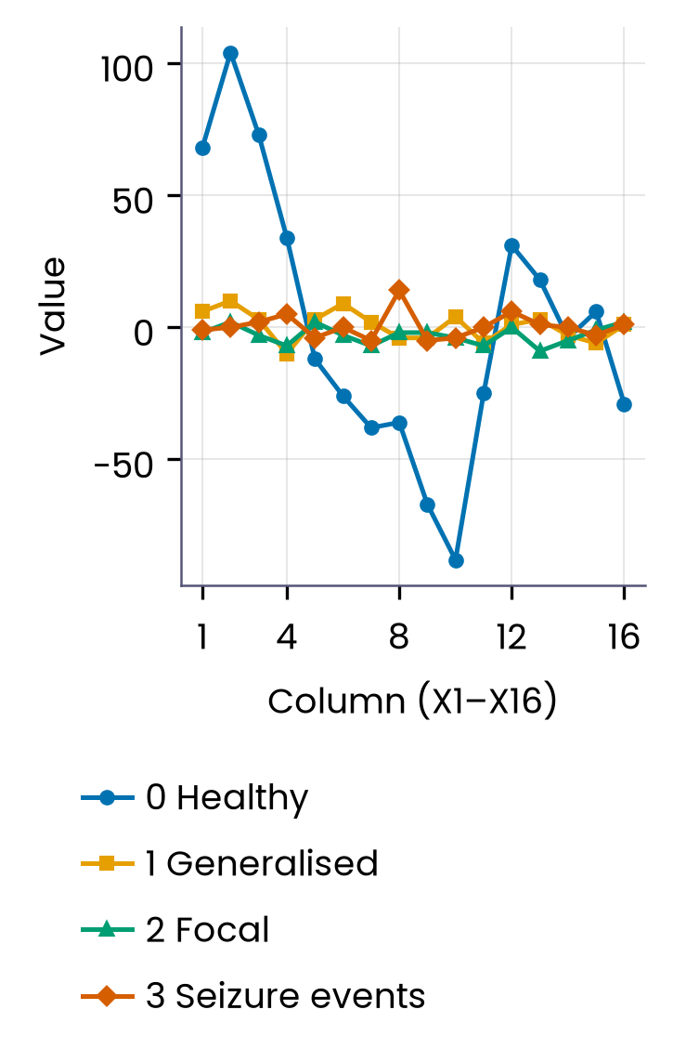
1. Introduction: The BEED Dataset
8,000 rows · 16 values per row (X1–X16) · documented: 16 channels, 256 Hz [1]
0 · Healthy
1 · Generalised seizures
2,000 rows; documented as healthy adult subjects [1].
2,000 rows; seizures involving both hemispheres.
2 · Focal seizures
3 · Seizure events
Fig. 2. One BEED row per class; healthy rows show far larger amplitude.
2,000 rows; onset in a restricted brain region.
2,000 rows; events with blinking or staring behaviours.
NIELIT Bio-AI Conclave 2026 · Track 5
4 / 16
Notes:
Speaker notes: BEED is distributed as a single table of 8,000 rows, each holding 16 integer values labelled X1 to X16. There are four classes of 2,000 rows each: healthy, generalised seizures, focal seizures and seizure events with behaviours such as blinking or staring. The documentation describes 16-channel recordings at 256 Hz from a neurological centre in Bangalore; the file itself has no subject or recording identifiers, and in the audit we compare the documentation with what the file contains. Note the much larger amplitude of the healthy row in the figure; we return to this in the audit.
Sources: [1] Najmusseher N, Nizar Banu PK. BEED: Bangalore EEG Epilepsy Dataset [dataset]. UCI Machine Learning Repository. 2024. doi:10.24432/C5K33B. Row/class counts, X1–X16, 256 Hz, class definitions: BEED_paper_camera_ready.docx (Introduction, Methods 3.1). Figure: redrawn for the slide from /workspace/beed/raw/BEED_Data.csv (4th row of each class, as in code/figures/fig_examples.png panel a) by figs/make_figs.py.

Slide 5
1. Introduction:
Research Questions
Random row split
Standard practice in prior BEED studies.
Adjacent rows can land in train and test.
RQ1 What do BEED rows and columns represent, and is this the same across classes?
RQ2 How much performance survives evaluation without temporal leakage?
RQ3 Once shortcuts are controlled, what separates the three seizure types?
RQ4 What is the computational footprint on a general-purpose CPU?
Leakage-safe block split
Blocked CV: 200-row blocks.
Rolling origin: five 20% test blocks.
50-row purge gaps on both sides.
NIELIT Bio-AI Conclave 2026 · Track 5
5 / 16
Notes:
Speaker notes: We address four research questions. RQ1: what the rows and columns of the public BEED file represent, and whether that representation is the same across classes. RQ2: how much of the reported performance survives an evaluation that prevents temporal leakage. RQ3: once shortcuts are controlled, which signal properties separate generalised, focal and seizure-event recordings. RQ4: what the computational footprint of the candidate models is on a general-purpose CPU; we did not measure wearable or microcontroller hardware. Most prior BEED work uses a random row split, so neighbouring rows from the same recording can sit on both sides of the split. Our leakage-safe protocols hold out contiguous blocks with 50-row purge gaps: 200-row blocks in blocked cross-validation, and a five-fold rolling-origin evaluation in which every 20% block of every recording is tested once.
Sources: RQ1–RQ3: BEED_paper_camera_ready.docx (Introduction, research questions); RQ4 revised wording and rolling-origin protocol: /workspace/beed/revision_v2/REVISION_RESULTS.md (R8 "Suggested RQ4 wording"; R1 rolling origin); blocked protocol: BEED_paper_camera_ready.docx (Methods).

Slide 6
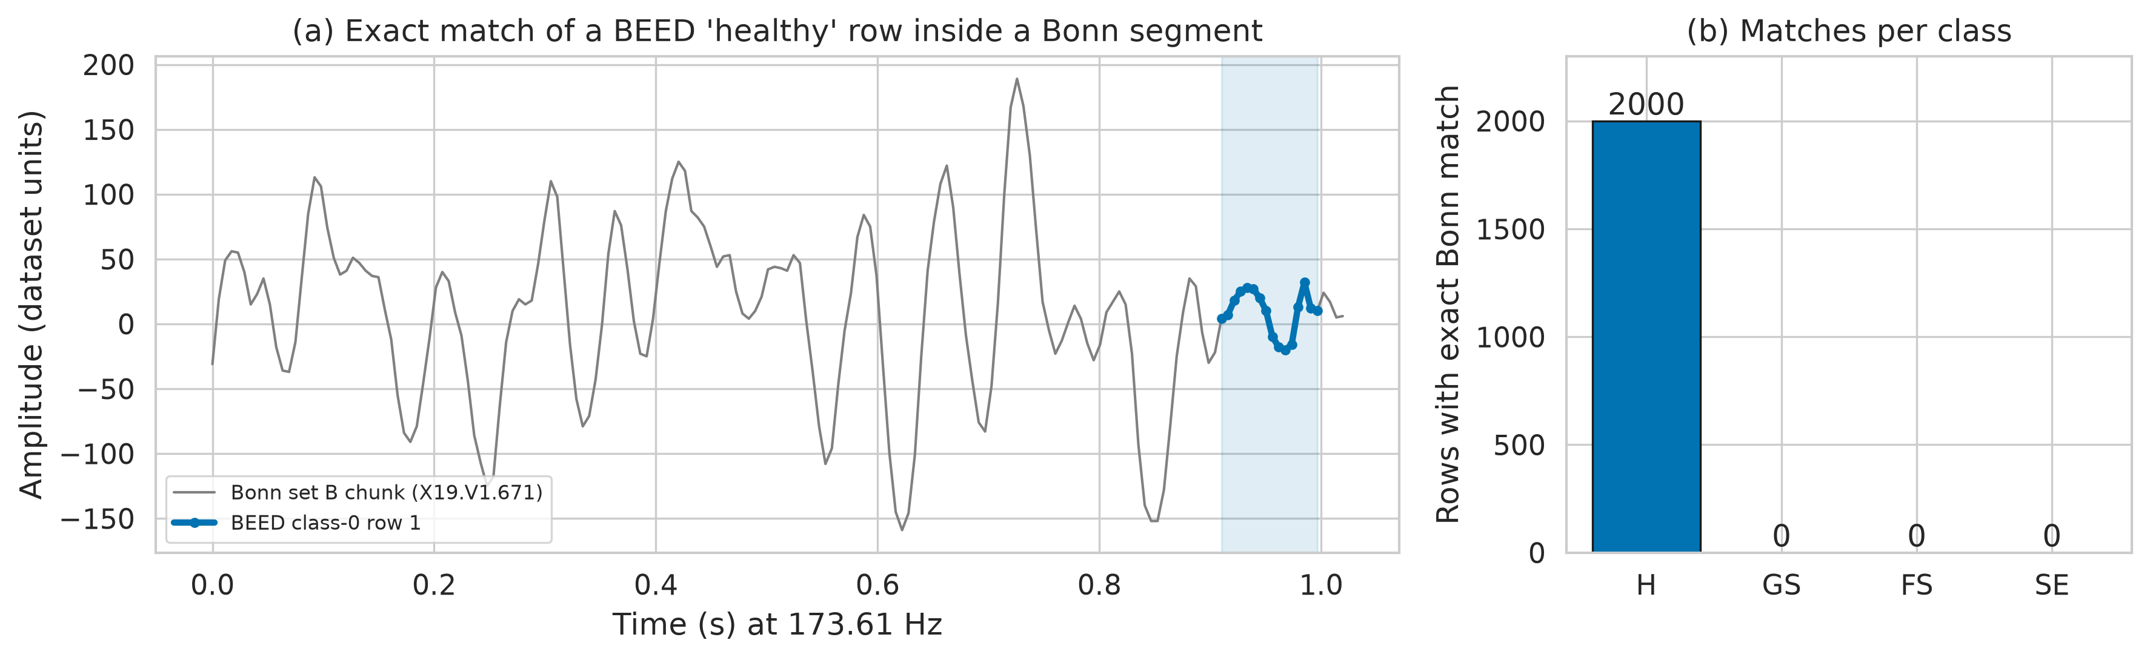
2. Dataset Audit:
Where the Healthy Class Comes From
Match
All 2,000 healthy rows are identical to UCI windows [3], all at samples 159–174; classes 1–3: none.
Source
Bonn set B, eyes closed, 173.61 Hz [2]; classes 1–3: 256 Hz.
UCI page
Describes 80 × 200 = 16,000 segments, binary y; file: 8,000 rows, 4 classes, no subject IDs.
Effect
A single smoothness threshold separates healthy rows (accuracy 0.997).
Fig. 3. A BEED healthy row identical to a Bonn set-B window (a); matches per class (b).
NIELIT Bio-AI Conclave 2026 · Track 5
6 / 16
Notes:
Speaker notes: When we searched for the healthy rows in older public data, every one of the 2,000 rows was identical to a 16-sample window of the UCI Epileptic Seizure Recognition file, which is derived from Bonn set B, healthy volunteers with eyes closed. Every match sits at the same position, samples 159 to 174 of a one-second chunk, and no row from the three seizure classes matches. The healthy rows are therefore identical to data from a different recording source, sampled at 173.61 Hz rather than 256 Hz. The UCI documentation also does not describe the file: it speaks of 80 subjects with 200 time points each, 16,000 segments of 20 seconds and a binary label, whereas the file has 8,000 rows, four classes and no subject identifiers. As a consequence, healthy and seizure rows can be told apart by recording source alone: one smoothness threshold reaches 0.997 accuracy.
Sources: [2] Andrzejak RG, Lehnertz K, Mormann F, Rieke C, David P, Elger CE. Physical Review E. 2001;64(6):061907. doi:10.1103/PhysRevE.64.061907. [3] Wu Q, Fokoue E. Epileptic Seizure Recognition [dataset]. UCI Machine Learning Repository. 2017. doi:10.24432/C5G308 (reference per /workspace/beed/revision_v2/LITERATURE_REVISION.md [18]). Match results, positions, 173.61 Hz, 0.997 threshold accuracy: BEED_paper_camera_ready.docx (Results 4.2, 4.4; paper Fig. 2). UCI documentation (80 subjects, 200 time points per subject, 16,000 segments, binary y vs 8,000 rows, 4 classes, no subject column): https://archive.ics.uci.edu/dataset/1134, quoted in /workspace/beed/revision_v2/notes/R2_UCI_documentation.md and REVISION_RESULTS.md R2. Figure: code/figures/fig_provenance.png.

Slide 7
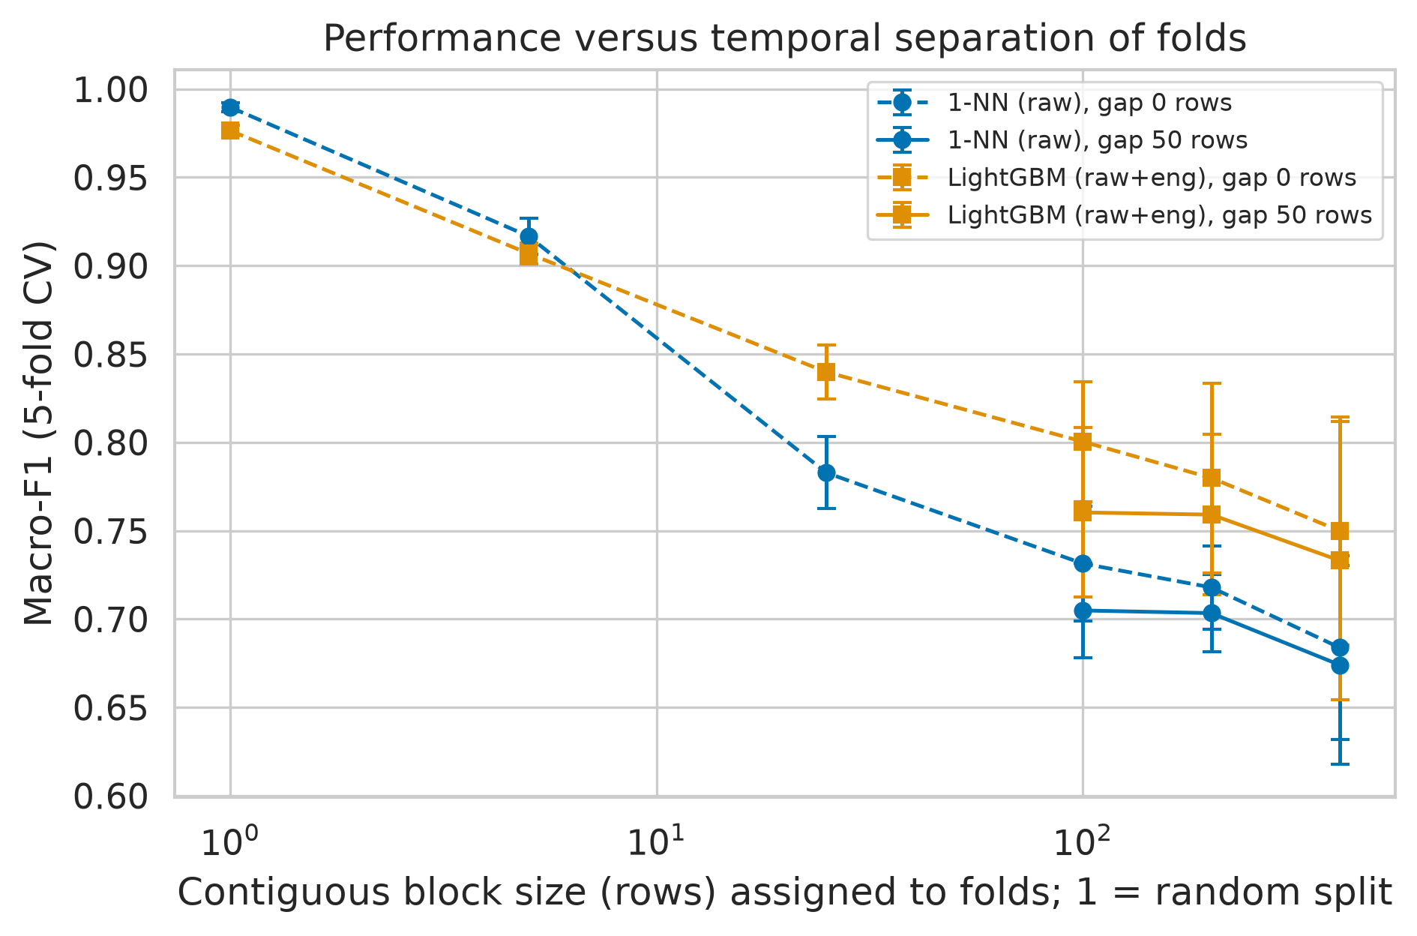
2. Dataset Audit:
Temporal Leakage
Consecutive seizure-class rows are adjacent time points, hence near-duplicates.
Random split
88–95% of seizure test rows have their neighbouring row in training.
Fig. 4. Macro-F1 falls as folds use longer row blocks.
Implication
Random-split scores measure interpolation, not generalisation.
NIELIT Bio-AI Conclave 2026 · Track 5
7 / 16
Notes:
Speaker notes: In the three seizure classes, each row is one time point of a continuous recording, so neighbouring rows are almost identical. With a random row split, between 88 and 95 percent of seizure test rows have their immediate neighbour in the training set. A classifier can then simply look up the neighbour, so random-split scores measure interpolation rather than generalisation. The figure shows macro-F1 falling steadily as folds are built from longer contiguous blocks.
Sources: leakage_nearest_neighbour.csv (nn_within_1_row 0.878–0.953 for classes 1–3); BEED_paper_camera_ready.docx Results 4.3 (87.8%–95.2%); figure code/figures/fig_block_curve.png.

Slide 8
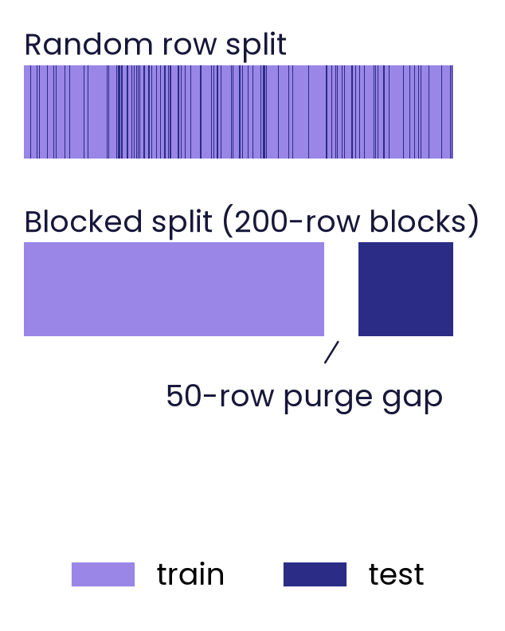
3. Methodology
Macro-F1 throughout; model pre-specified by blocked CV on development data
Splits
Models
Random 80/20 vs blocked 5×2 CV with 200-row blocks and 50-row purge gaps.
Primary: LightGBM (raw). Also LR, kNN, SVM-RBF, RF, XGBoost, four deep nets.
Fig. 5. Schematic: random versus blocked hold-out with a purge gap.
Statistics
Estimates
Cluster-bootstrap CIs; corrected t-tests, Holm; Friedman/Nemenyi descriptive (anti-conservative).
Primary: five-fold rolling origin. Secondary: final-20% hold-out.
NIELIT Bio-AI Conclave 2026 · Track 5
8 / 16
Notes:
Speaker notes: We compare a random 80/20 row split, as in most prior work, with leakage-safe protocols that hold out whole 200-row blocks, or whole Bonn segments for the healthy class, and purge training rows within 50 rows of any test row. The primary model was pre-specified: LightGBM on raw values, the configuration with the best macro-F1 in the purged blocked five-by-two cross-validation on the development data; the test block was never used for selection. Our primary estimate is a five-fold rolling-origin evaluation, in which each 20% block of every recording is tested once; the single final-20% hold-out is reported as a secondary result. We also compare five other classical models and four small deep networks. Uncertainty uses cluster-bootstrap confidence intervals and corrected resampled t-tests with Holm adjustment. Friedman and Nemenyi tests over cross-validation folds are anti-conservative, because the folds share training data, so we report them as descriptive only.
Sources: BEED_paper_camera_ready.docx Methods 3.3 (protocols), 3.5 (models). Pre-specified primary model, rolling origin, hold-out as secondary: /workspace/beed/revision_v2/REVISION_RESULTS.md R1 (results/R1_primary_model_headline.csv). Holm across settings and Friedman/Nemenyi caveat: REVISION_RESULTS.md R9. Figure: schematic drawn for this talk (figs/make_figs.py).

Slide 9
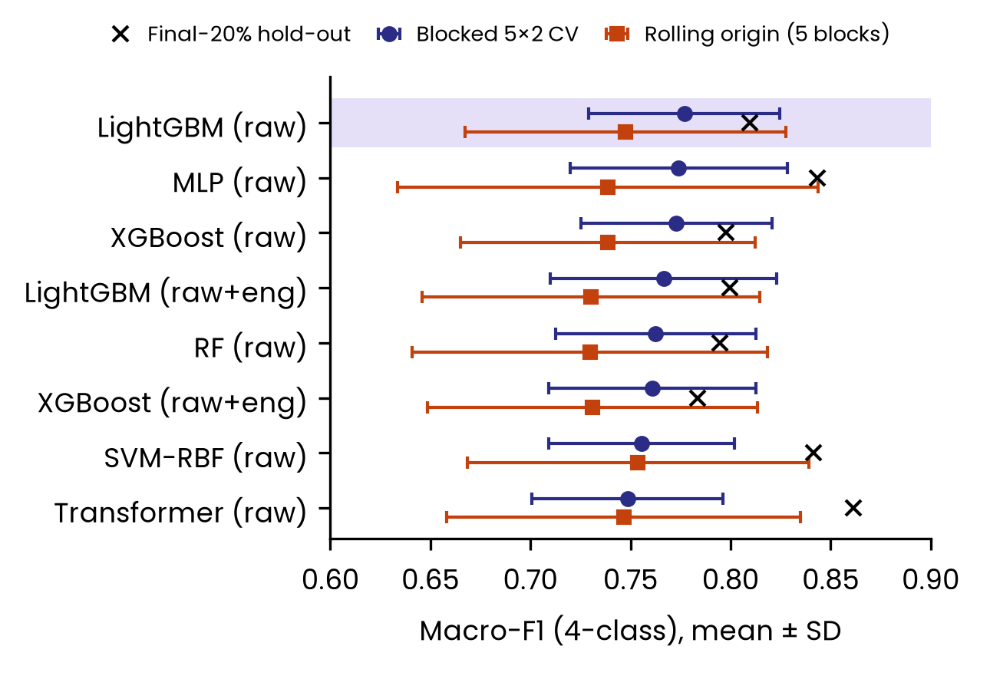
4. Results: Random vs Leakage-Safe Split
 | Random | Leakage-safe
4-class macro-F1 | 0.98 | 0.75 ± 0.08
3-class macro-F1 | 0.98 | 0.68 ± 0.10
Single hold-out | – | 0.81 / 0.75
Random: best model (kNN, raw), random-split CV. Leakage-safe: LightGBM (raw), chosen by blocked CV; five-fold rolling origin, mean ± SD. Single hold-out: final 20%, secondary (4-class / 3-class). 3-class: seizure types only.
Fig. 6. Four-class leakage-safe macro-F1, top eight models by blocked CV; shaded: primary model.
NIELIT Bio-AI Conclave 2026 · Track 5
9 / 16
Notes:
Speaker notes: Under a random row split the best model, kNN, reaches a macro-F1 of 0.98 for four classes and also 0.98 for the three seizure types. Under the leakage-safe protocol, the pre-specified LightGBM on raw values reaches 0.75 plus or minus 0.08 for four classes and 0.68 plus or minus 0.10 for the seizure types, as mean and standard deviation over five rolling-origin test blocks. The single final-20% hold-out gives 0.81 and 0.75, but it is one of the easier blocks for every model, so we treat it as secondary. The figure shows the eight best models by blocked cross-validation: their estimates overlap, the ranking is not stable, and single hold-out scores sit above the rolling-origin means.
Sources: /workspace/beed/revision_v2/REVISION_RESULTS.md R1 and "Suggested replacement for the deck's headline numbers"; results/R1_primary_model_headline.csv (4-class rolling 0.748 ± 0.080, hold-out 0.810; 3-class rolling 0.677 ± 0.104, hold-out 0.752); results/R1_table4_extended_cv.csv (random protocol, kNN raw: 4-class 0.984 ± 0.004, 3-class 0.983 ± 0.006). Figure 6: redrawn for the slide from results/R1_table4_extended_cv.csv, R1_rolling_origin_summary.csv, R1_holdout_fold_scores.csv and R7_deep_fold_scores_part*.csv (same data as figures/R1_cv_rolling_holdout.png, 4-class panel, top eight models).

Slide 10
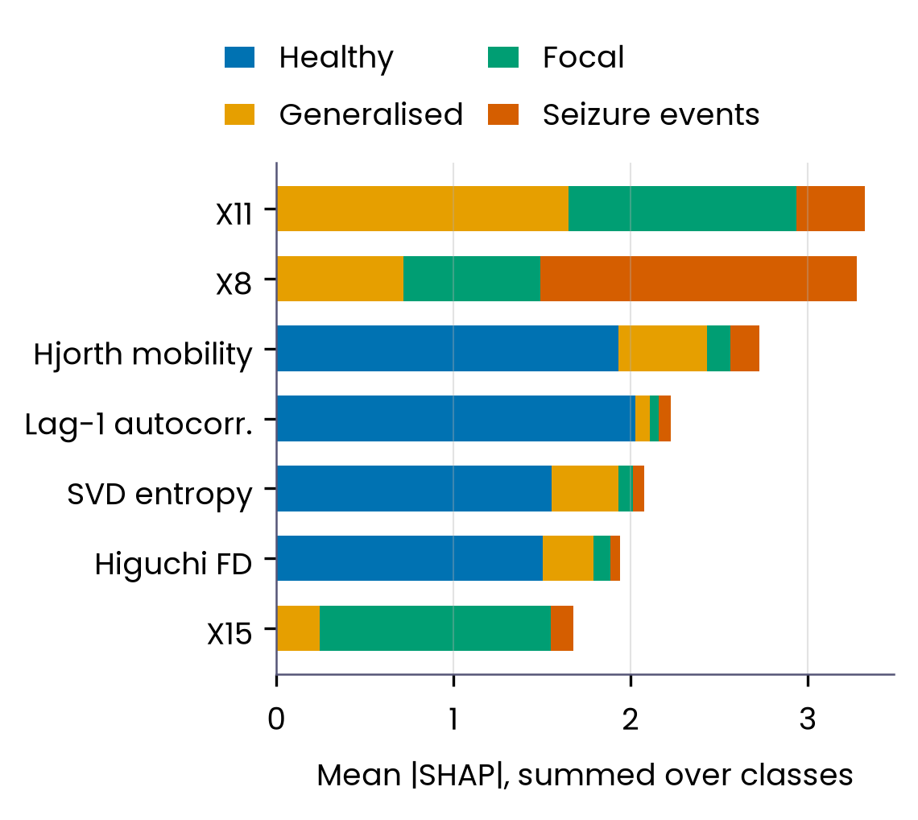
4. Results:
What the Models Look At
Leakage-safe feature importance
Seizure types: a per-channel spatial amplitude pattern (X11, X8, X15); see slide 11.
Healthy class: smoothness, e.g. Hjorth mobility.
Healthy class: a recording-source shortcut
Healthy vs seizure: macro-F1 ≥ 0.99 for every model (best 0.999–1.000).
One lag-1 autocorrelation threshold: accuracy 0.997.
Fig. 7. Top SHAP features, LightGBM, four classes, leakage-safe split.
NIELIT Bio-AI Conclave 2026 · Track 5
10 / 16
Notes:
Speaker notes: Under the leakage-safe split, the seizure classes are separated mainly by the values of particular channels, X11, X8 and X15: a per-channel spatial amplitude pattern across electrodes. The next slide shows that this pattern behaves like a fingerprint of each recording. The healthy class is separated almost entirely by smoothness descriptors such as Hjorth mobility and lag-1 autocorrelation. Healthy versus seizure is solved with macro-F1 of at least 0.99 for every model (best 0.999 to 1.000), and a single threshold on lag-1 autocorrelation alone reaches 0.997 accuracy. This is a recording-source shortcut, not a clinical signal.
Sources: shap_4class_blocked.csv (top summed |SHAP|: X11 3.32, X8 3.28, t_hjorth_mob 2.73, t_lag1_ac 2.23, n_svd_entropy 2.08, n_higuchi_fd 1.94, X15 1.68); shap/Results 4.7 of BEED_paper_camera_ready.docx (3-class blocked leaders X11, X8, X15, X12, X6); holdout_metrics.csv binary blocked best macro-F1 0.9992; shortcut_stumps.csv blocked t_lag1_ac accuracy 0.9975. Spatial amplitude pattern interpretation: /workspace/beed/revision_v2/REVISION_RESULTS.md R4. Figure redrawn from shap_4class_blocked.csv (figs/make_fig7.py).

Slide 11
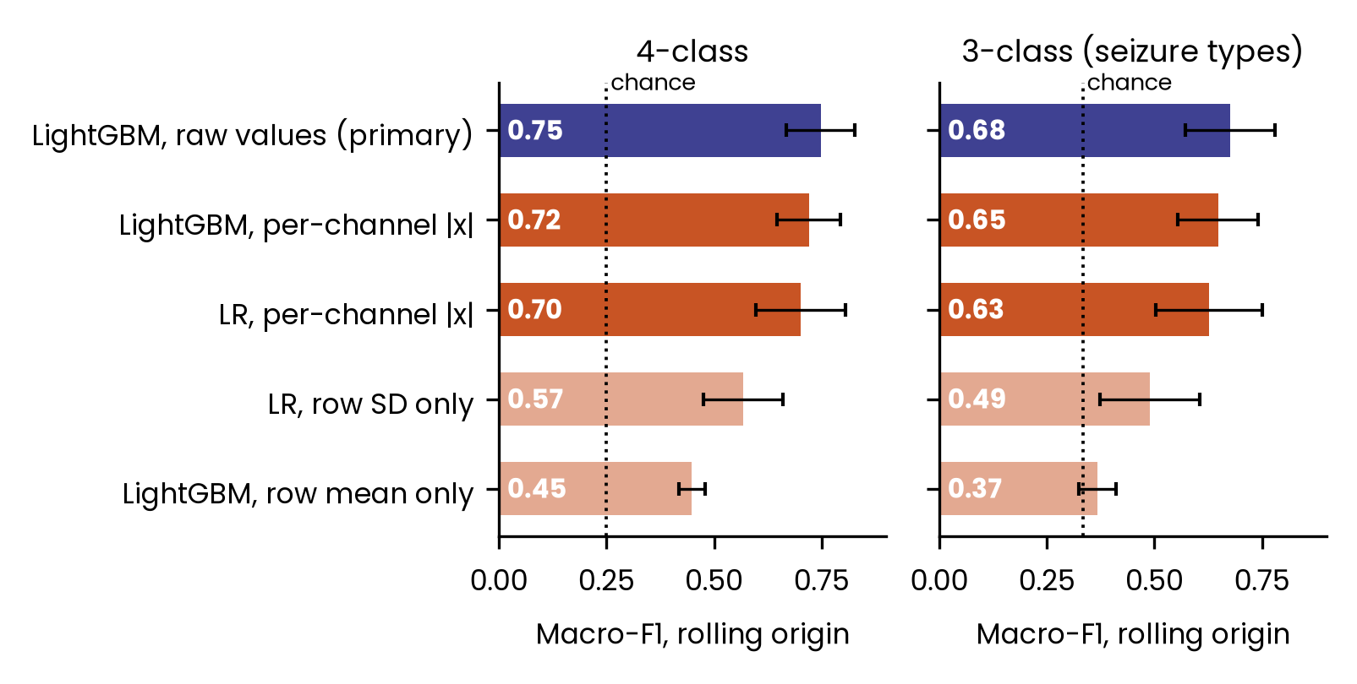
4. Results:
A Recording Fingerprint
Feature
Per-channel |x| only: 16 sign-free amplitudes, LightGBM.
4-class
0.72 ± 0.07 vs 0.75 ± 0.08 (full model).
3-class
0.65 ± 0.09 vs 0.68 ± 0.10 (full model).
Test
About 90% of above-chance score. Primary vs LR on |x|: +0.05, Holm p = 0.15–0.16, not significant.
Fig. 8. Rolling-origin macro-F1 (mean ± SD) of the primary model and amplitude-only baselines.
NIELIT Bio-AI Conclave 2026 · Track 5
11 / 16
Notes:
Speaker notes: How much of the leakage-safe score is seizure physiology? We trained models on a deliberately poor feature: only the absolute value of each of the 16 channels, which keeps the amplitude pattern but discards sign and any temporal information. LightGBM on these 16 values reaches 0.72 plus or minus 0.07 for four classes and 0.65 plus or minus 0.09 for the three seizure types in the rolling-origin evaluation, against 0.75 and 0.68 for the primary model on raw values. That is about 90% of the primary model's performance above chance. In the pre-specified test, the primary model beats logistic regression on these features by about 0.05, and after Holm correction this is not significant, p = 0.15 to 0.16. Each seizure class appears to be a single recording or a few seamlessly joined pieces; we could not determine which. Recording identity and seizure type are therefore likely confounded, and the leakage-safe score mostly measures a recording-specific amplitude fingerprint rather than seizure type.
Sources: /workspace/beed/revision_v2/REVISION_RESULTS.md R4 (results/R4_fingerprint_baselines.csv: rolling origin 4-class LightGBM raw 0.748 ± 0.080, LightGBM |x| 0.720 ± 0.074, LR |x| 0.702 ± 0.104; 3-class 0.677 ± 0.104, 0.648 ± 0.094, 0.627 ± 0.124; share of above-chance performance 0.945 / 0.916 for LightGBM |x|) and R9 (results/R9_prespecified_tests.csv: differences +0.046 to +0.054, Holm p 0.151–0.163). Artefact rows (recstd_raw) not used. Figure 8: redrawn for the slide from R4_fingerprint_baselines.csv (rolling-origin mean ± SD; chance 0.25 / 0.33).

Slide 12
4. Results: Computational Footprint (Server CPU)
Model (input) | Parameters | ONNX size | ms / sample | Macro-F1
MLP, tuned (raw 16) | 3.5k | 16 kB | 0.05 | 0.77 (CV)
LightGBM, tuned (raw+eng., 73) | 28.7k nodes | 1.06 MB | 3.97† | 0.799 (hold-out)
Single thread, Intel Xeon server CPU (8-vCPU VM), Python; median of 500 single-sample calls; not edge hardware. †Includes 3.48 ms feature extraction.
LightGBM row: the tuned raw+engineered-features model (73 features), not the primary raw-value model; 0.799 is a single hold-out.
MLP 0.77 is its tuned blocked 5×2 CV macro-F1 (0.774 ± 0.054).
LightGBM inference alone: 0.50 ms (0.02 ms in ONNX Runtime); about 87% of its cost is feature extraction.
NIELIT Bio-AI Conclave 2026 · Track 5
12 / 16
Notes:
Speaker notes: We measured the computational footprint on a general-purpose server CPU, one thread of an Intel Xeon virtual machine, as the median of 500 single-sample calls. The tuned MLP has 3,492 parameters, serialises to 16 kB in ONNX and takes about 0.05 ms per sample; its blocked five-by-two cross-validated macro-F1 is 0.77. The LightGBM row is the tuned model on raw plus engineered features, 73 in total, not the primary raw-value model: 1.06 MB in ONNX and 3.97 ms per sample, of which 3.48 ms, about 87%, is Python feature extraction. Its 0.799 is a single hold-out score. These figures were not measured on wearable or microcontroller hardware and do not establish edge feasibility.
Sources: /workspace/beed/revision_v2/REVISION_RESULTS.md R8; results/R8_computational_footprint.csv (Intel Xeon, 1 thread, Python 3.13.5, server VM; LightGBM tuned raw+eng 73 features, 28,658 nodes, ONNX 1,062 kB, feature extraction 3.476 ms, inference 0.498 ms Python / 0.019 ms ONNX RT, total 3.974 ms, blocked hold-out F1 0.799; MLP tuned 3,492 params, ONNX 15.9 kB, 0.054 ms); MLP tuned 5×2 blocked CV 0.774 ± 0.054: REVISION_RESULTS.md R7.

Slide 13
Data
5. Discussion:
Limitations
No subject IDs, so no patient-level test.
Recording identity and seizure type likely confounded (fingerprint result).
Healthy class from Bonn set B; single dataset, no external test.
What remains valid
Leakage-safe scores estimate extrapolation to unseen time within the same recordings, not seizure-type generalisation.
Methods
CHB-MIT search for classes 1–3 found no match but was partial: 246 of 686 files, all 24 subjects; best 0.42 vs 0.80 threshold [5].
Friedman/Nemenyi anti-conservative; deep models tuned on one inner hold-out; no edge hardware.
NIELIT Bio-AI Conclave 2026 · Track 5
13 / 16
Notes:
Speaker notes: Several limitations follow from the data. The file has no subject identifiers, so no patient-independent test is possible, and recording identity and seizure type are likely confounded: a per-channel amplitude fingerprint reproduces most of the leakage-safe score, and each seizure class is consistent with one, or a few seamlessly joined, recordings, although we could not determine which. The healthy class comes from Bonn set B, and we used a single dataset with no external test set. On the methods side, we searched the CHB-MIT Scalp EEG Database for the source of classes 1 to 3 with a gain-, offset- and channel-order-invariant cross-correlation. The search was negative but partial: 246 of 686 files, from all 24 subjects, and no file exceeded a score of 0.42 against a threshold of 0.80, while a positive control scored 1.00. Friedman and Nemenyi tests over cross-validation folds are anti-conservative because folds share training data, so we treat them as descriptive. Deep models were tuned on a single inner hold-out rather than inner cross-validation, to save compute. Finally, the footprint was measured on a server CPU, not on edge hardware. What remains valid is that leakage-safe scores estimate extrapolation to unseen time within the same recordings, not seizure-type generalisation.
Sources: /workspace/beed/revision_v2/REVISION_RESULTS.md R5 (CHB-MIT v1.0.0, 246 of 686 files, 281.7 h, all 24 subjects, 136 of 141 seizure records; max scores 0.38 / 0.26 / 0.42; threshold 0.80; positive control 1.000; results/r5_chbmit_scan.csv; file list notes/chbmit_RECORDS.txt, 686 entries), R9 (Friedman/Nemenyi caveat), R7 (deep-model inner hold-out), R8 (server CPU, no edge hardware), R2 (no subject IDs; change-point analysis consistent with one or a few seamlessly joined recordings per seizure class; "could not determine whether each seizure class comes from one or several recordings") and R4 (fingerprint confound). [5] Guttag J. CHB-MIT Scalp EEG Database (version 1.0.0). PhysioNet. 2010. doi:10.13026/C2K01R (verified https://physionet.org/content/chbmit/1.0.0/, 8 Oct 2026); PhysioNet standard citation: Goldberger AL, Amaral LAN, Glass L, et al. PhysioBank, PhysioToolkit, and PhysioNet. Circulation. 2000;101(23):e215–e220. doi:10.1161/01.CIR.101.23.e215 (verified via Crossref). Healthy-class source: BEED_paper_camera_ready.docx Results 4.2.

Slide 14
6. Conclusion: Takeaways and Future Work
Takeaways
Future work
Random split 0.98 vs leakage-safe 0.75 ± 0.08 (3-class: 0.98 vs 0.68 ± 0.10).
Subject and recording metadata from the dataset creators.
Per-channel |x| alone reaches 0.72 / 0.65: mostly a recording fingerprint.
Validation on independent public EEG data.
Healthy rows identical to Bonn set B windows [2], [3]: a source shortcut.
Same-source healthy recordings.
Report pre-specified, leakage-safe (rolling-origin) estimates for BEED.
Wider source search: TUSZ, Siena, filtered derivatives.
NIELIT Bio-AI Conclave 2026 · Track 5
14 / 16
Notes:
Speaker notes: To conclude: random splits leak. The best model reaches 0.98 under a random split, but the pre-specified leakage-safe estimate is 0.75 plus or minus 0.08 for four classes and 0.68 plus or minus 0.10 for the three seizure types. Most of what remains is a recording fingerprint: the per-channel absolute amplitudes alone reach 0.72 and 0.65. The healthy rows are identical to Bonn set B windows, a source shortcut. We therefore recommend reporting pre-specified, leakage-safe estimates such as rolling origin for BEED. For future work, we need subject and recording metadata from the dataset creators, validation on independent public EEG data, healthy recordings from the same source, and a wider source search covering TUSZ, Siena and filtered or resampled derivatives. Thank you.
Sources: /workspace/beed/revision_v2/REVISION_RESULTS.md R1 (random kNN raw 0.984 / 0.983; rolling origin LightGBM raw 0.748 ± 0.080 / 0.677 ± 0.104), R4 (LightGBM on per-channel |x| 0.720 / 0.648), R5 caveats (unsearched corpora TUSZ, Siena; resampled or filtered derivatives), conclusion wording ("pre-specify the model and report rolling-origin or CV estimates"); healthy-class identity: BEED_paper_camera_ready.docx Results 4.2, refs [2] Andrzejak 2001, [3] Wu & Fokoue 2017.

Slide 15
References
[1] Najmusseher N, Nizar Banu PK. BEED: Bangalore EEG Epilepsy Dataset [dataset]. UCI Machine Learning Repository. 2024. doi:10.24432/C5K33B.
[2] Andrzejak RG, Lehnertz K, Mormann F, Rieke C, David P, Elger CE. Indications of nonlinear deterministic and finite-dimensional structures in time series of brain electrical activity: dependence on recording region and brain state. Physical Review E. 2001;64(6):061907. doi:10.1103/PhysRevE.64.061907.
[3] Wu Q, Fokoue E. Epileptic Seizure Recognition [dataset]. UCI Machine Learning Repository. 2017. doi:10.24432/C5G308. Copy distributed by the creators at github.com/QiuyiWu/Epileptic-Seizure-Recognition-Data (accessed 8 October 2026).
[4] World Health Organization. Epilepsy [fact sheet]. who.int/news-room/fact-sheets/detail/epilepsy (accessed 8 October 2026).
[5] Guttag J. CHB-MIT Scalp EEG Database (version 1.0.0). PhysioNet. 2010. doi:10.13026/C2K01R. Goldberger AL, et al. Circulation. 2000;101(23):e215–e220. doi:10.1161/01.CIR.101.23.e215.
Complete reference list: see the full paper.
NIELIT Bio-AI Conclave 2026 · Track 5
15 / 16
Notes:
Speaker notes: These are the five sources cited on the slides: the BEED dataset itself, the original Bonn EEG study, the UCI Epileptic Seizure Recognition file derived from it, the WHO epilepsy fact sheet, and the CHB-MIT Scalp EEG Database that we searched for the source of the seizure classes, with the standard PhysioNet citation. The full reference list, including the methods and statistics references, is in the paper.
Sources: [1], [2] exact text from BEED_paper_camera_ready.docx reference list (paper refs [7], [5]); [1] re-verified per /workspace/beed/revision_v2/LITERATURE_REVISION.md section 4. [3] corrected per LITERATURE_REVISION.md [18] (doi:10.24432/C5G308, registered with DataCite; UCI landing page returns '403 Dataset not approved', so the GitHub copy is kept). [4] WHO fact sheet, https://www.who.int/news-room/fact-sheets/detail/epilepsy, checked 8 October 2026 ('affecting around 50 million people worldwide'). [5] https://physionet.org/content/chbmit/1.0.0/ (Guttag J, 2010, doi:10.13026/C2K01R), verified 8 October 2026; Goldberger et al. 2000 verified via https://api.crossref.org/works/10.1161/01.CIR.101.23.e215.

Slide 16
THANK YOU
FOR YOUR ATTENTION
Questions?
Er. Rishabh Aryan
M.Tech (Artificial Intelligence and Data Science), Department of Computer Science and Engineering
Indian Institute of Information Technology, Bhagalpur (Bihar)
E-mail: rishabh.250201011@iiitbh.ac.in
ORCID ID: https://orcid.org/0009-0004-7595-9440
NIELIT Bio-AI Conclave 2026 · Track 5
16 / 16
Notes:
Speaker notes: Thank you for your attention. I am happy to take questions, and the code and full results are described in the paper. My contact details are on the slide.
Sources: presenter and contact details as supplied by the presenter.

